Slide 1
Simple deployment guide of Private DNS integration with On-premises
Notes:
Capacity and performance insights - Empower better quality of service

Slide 2
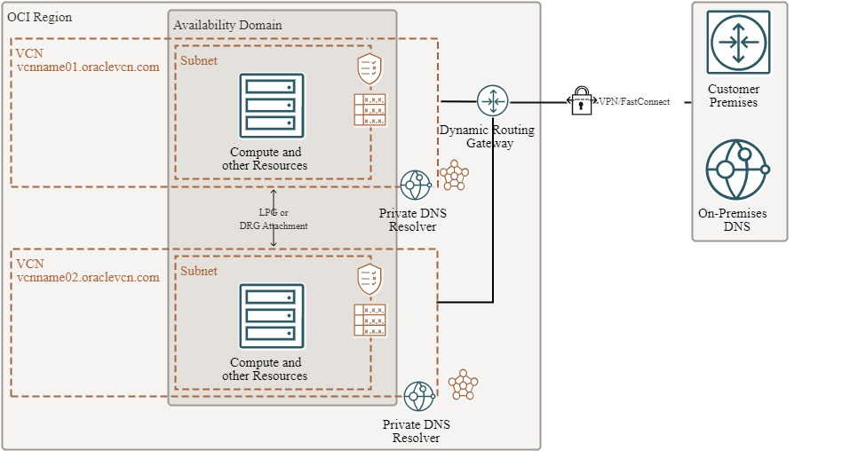
Architecture
OCI will create the DNS entries for Compute resources based on the private domain in the VCN
Private DNS resolver for DNS resolution to and from other private networks
You need to configure each VCN to resolve On-Premises resolution
Each VCN in a different DNS domain
Create a Listening Endpoint to Listen your On-premises DNS requests and resolve OCI DNS names
Create a Forwarding Endpoint to Forward request to On-Premises DNS requests
Create a Rule to Forward all On-premises for the On-Premises domain(s)

